Slide 1
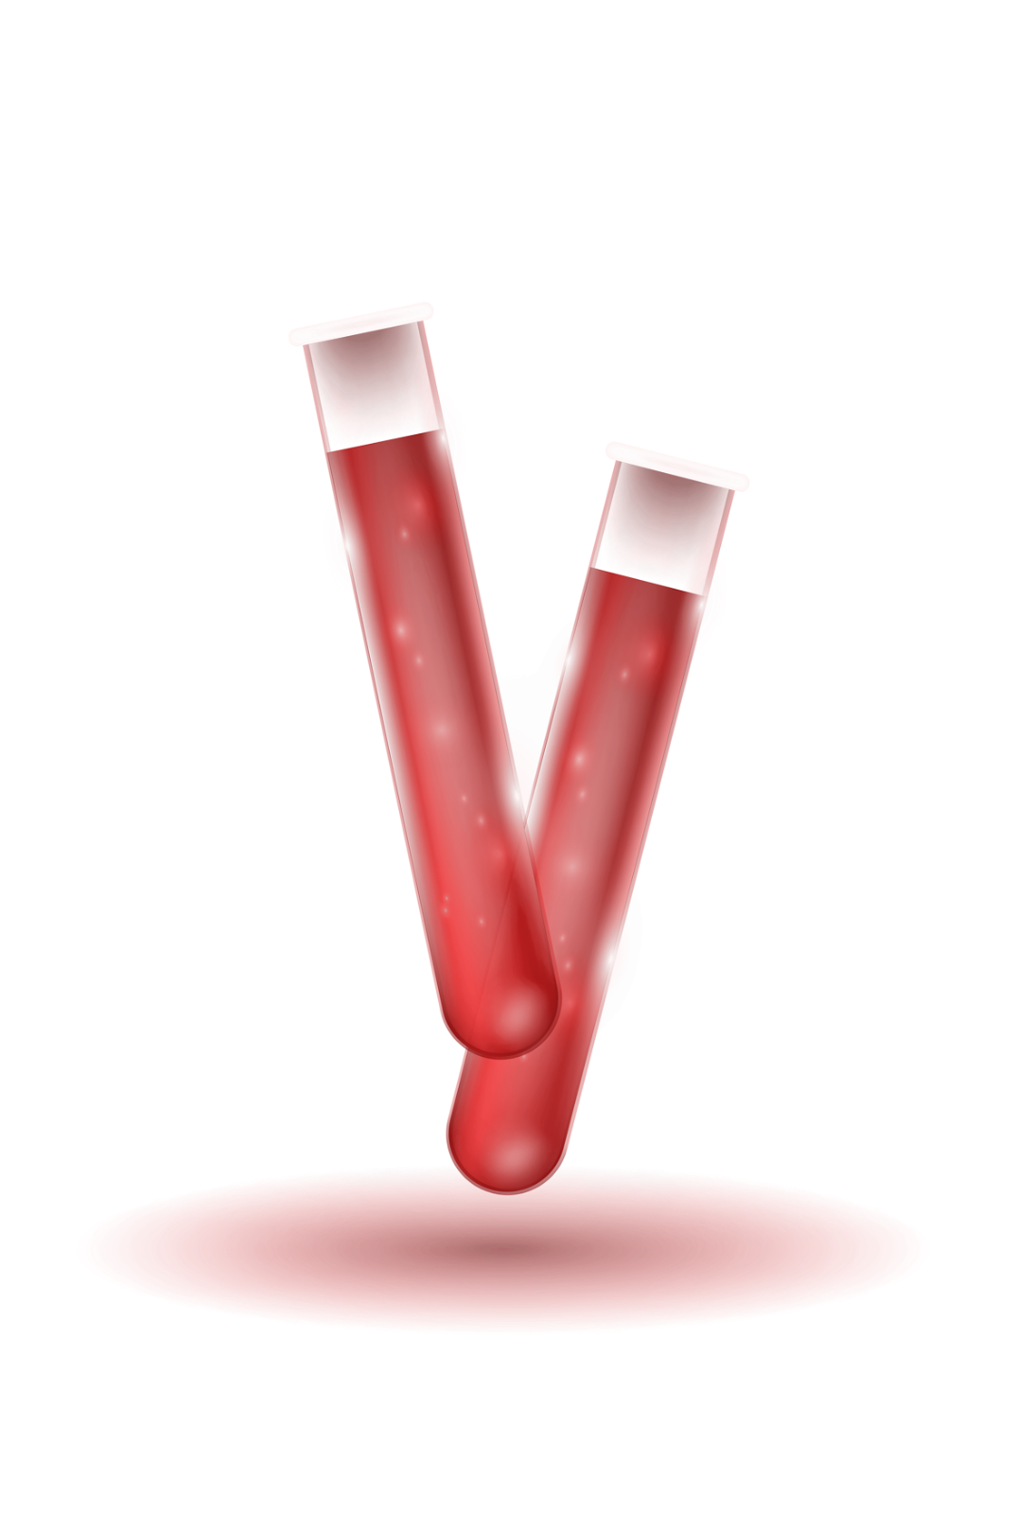

Welcome to MedAnalytica
Lab Manager: Shahed Batayha Contact: +962 79 5517 434 Location: Irbid-Alsareih
@MedAnalytica
LETS GET STARTED…

Slide 2


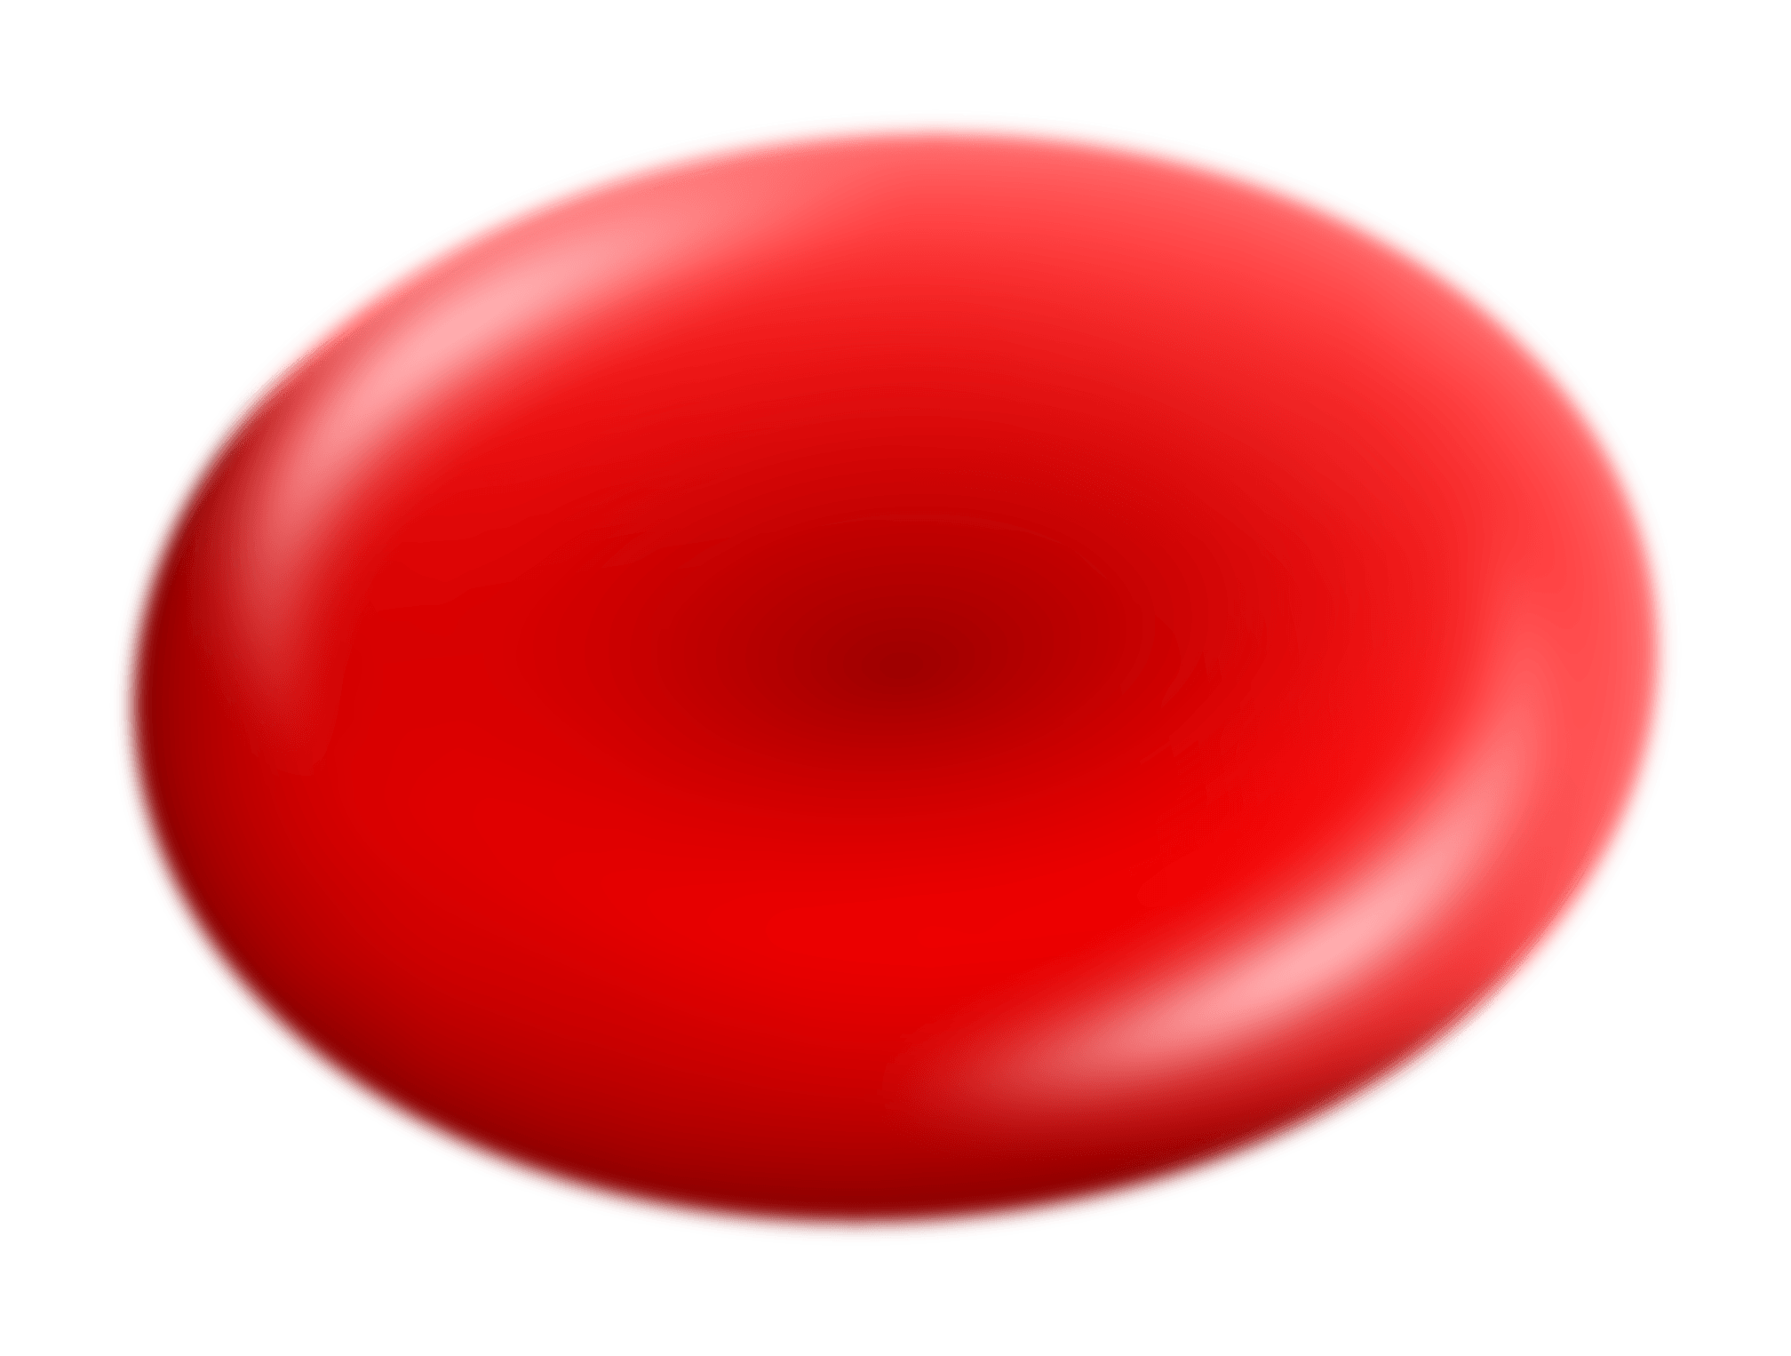
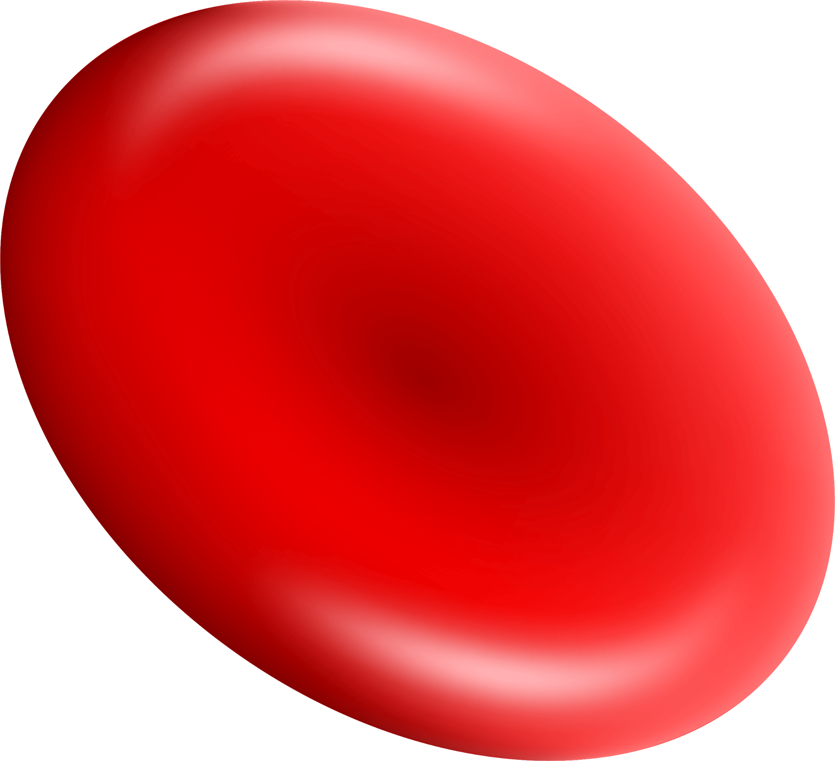
Why MedAnalytica?
01
02
03
04
]
Confusing Results
Anxiety & Wait
Patients often struggle to interpret complex medical reports.
Long waiting times for doctor appointments just to explain basic results.
Fragmented Info
Manual Tracking Error
Lack of personalized, immediate health advice based on lab values.
difficulty of manually tracking health changes over time without a digital history.

Slide 3

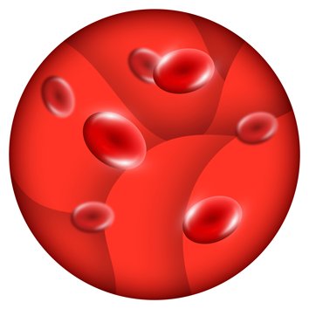
Our Solution
Instant Clarity !

Slide 4
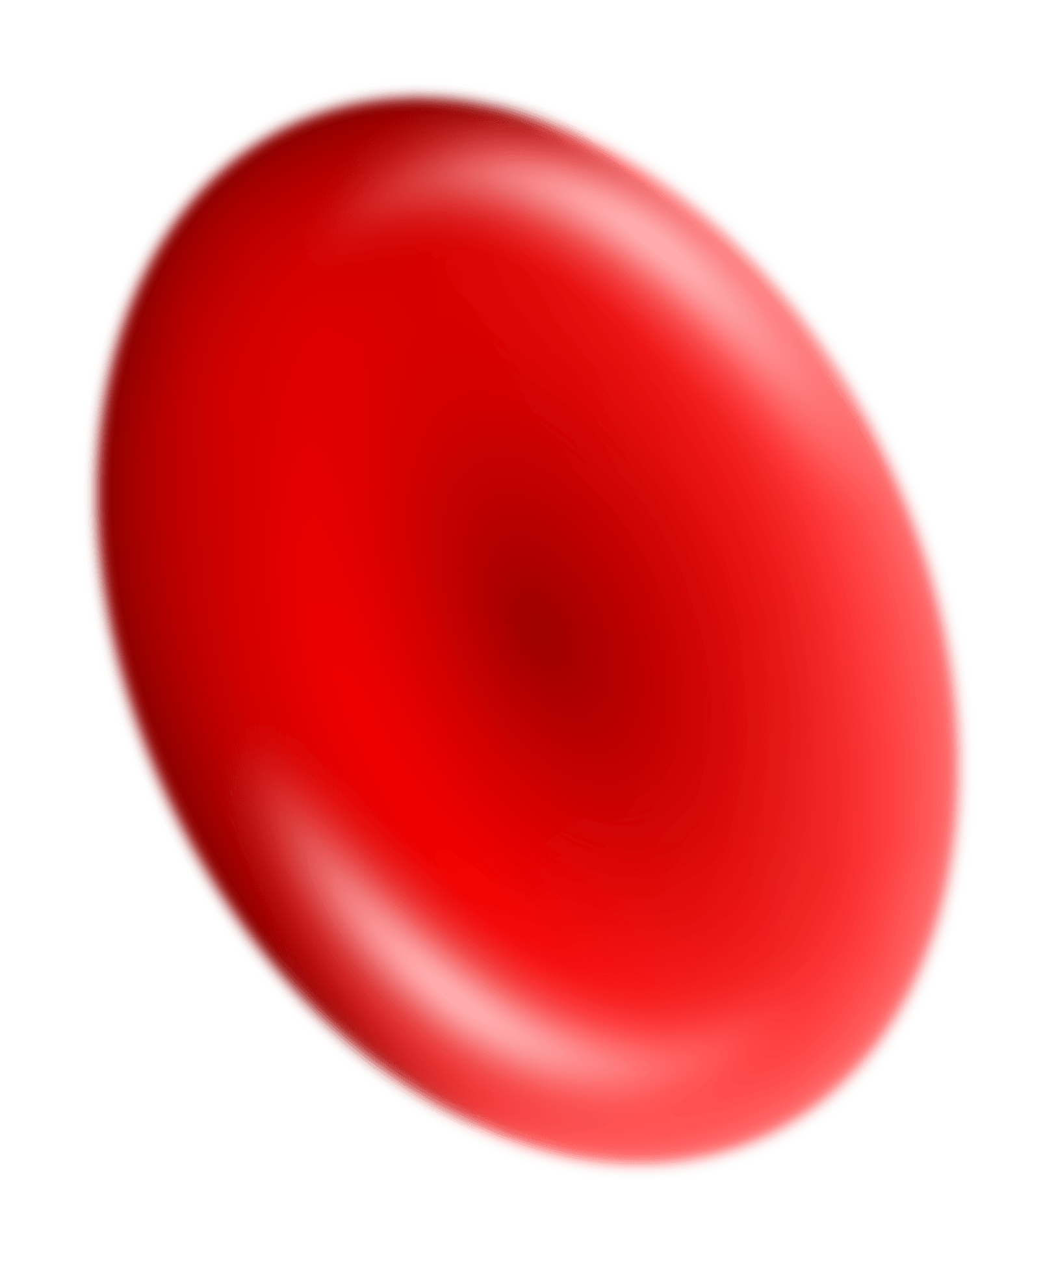
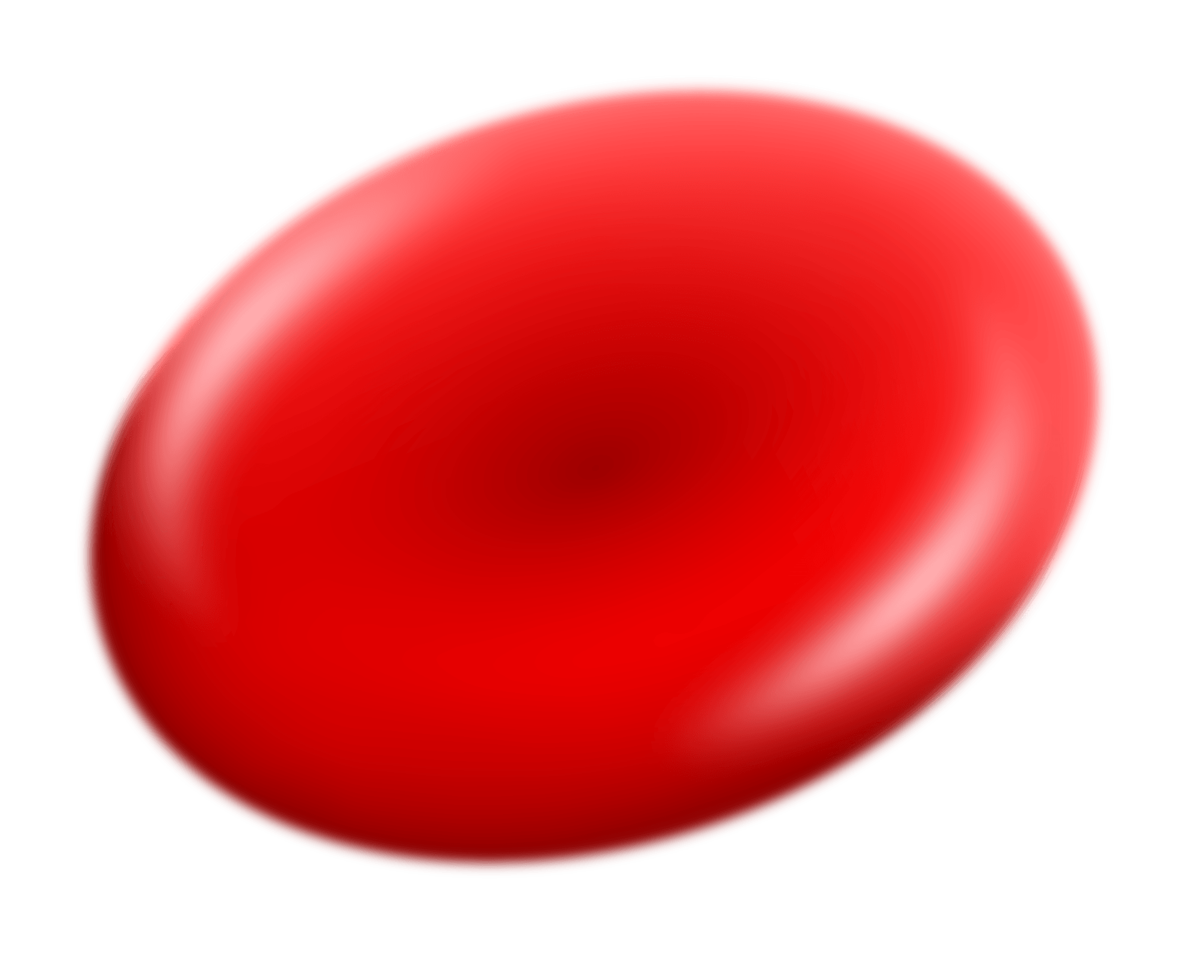
Our Solution
Instant Analysis
Personalized Advice
Automatically converts numbers into status (Normal, High, or Low).
Provides specific dietary and lifestyle guidance for each result.

Slide 5

How It Works (Technical Stack)
Prog language | Data logic | User interface | Data handling
Built entirely using Python. | Use Object-Oriented Programming for modularity. | Powered by Streamlit. | Uses Pandas for tables and reference range management.

Slide 6
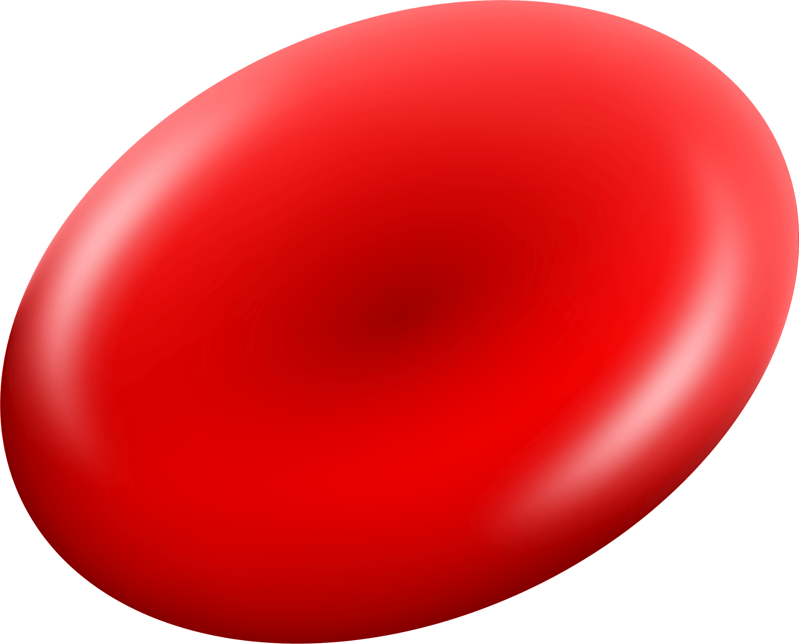
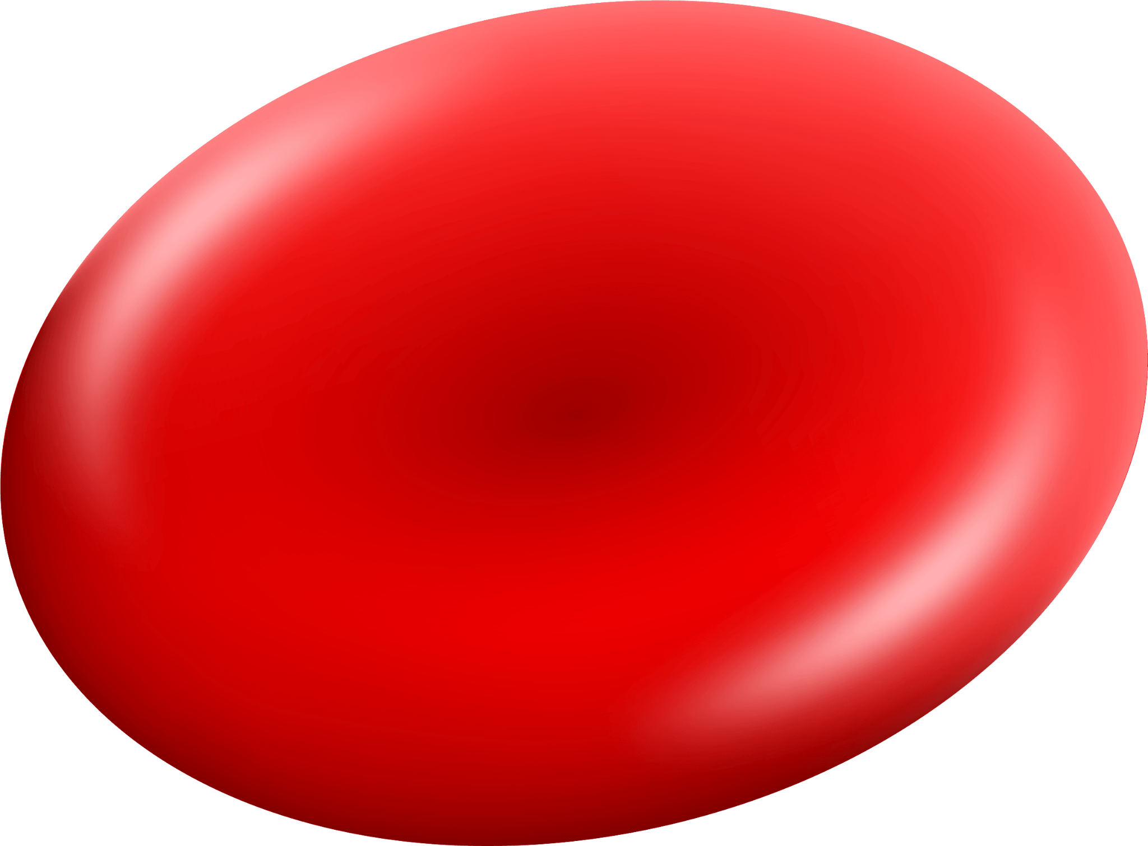
THANK YOU FOR YOUR TIME
The Future of MedAnalytica: “Our goal is to grow by adding AI to predict health trends and OCR technology to read lab reports from PDF files automatically. We also plan to launch a mobile app so users can track their health anywhere."

